Slide 1
EEE 2113 Electrical Circuits AC Circuits
Prepared by
Lec Saifur Rahman
Email: saifur@cse.uiu.ac.bd
Moblie: 01303529289

Slide 2
Chapter 9 Sinusoids and Phasors

Slide 3
Sinusoids
A sinusoid is a signal that has the form of the sine or cosine function.
Circuits driven by sinusoidal current or voltage sources are called AC circuits.
We are interested in sinusoids for:
Nature itself is characteristically sinusoidal. E.g., the pendulum's motion, the string's vibration, and the ripples on the ocean surface.
A sinusoidal signal is easy to generate and transmit.
Through Fourier analysis, any practical periodic signal can be represented by a sum of sinusoids.
A sinusoid is easy to handle mathematically. For example, the derivative and integral of a sinusoid are sinusoids.

Slide 4
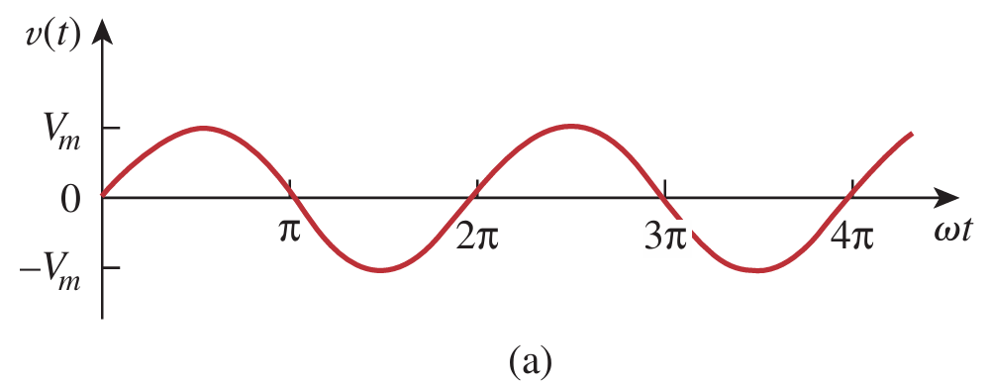
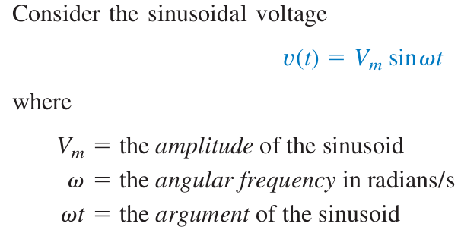
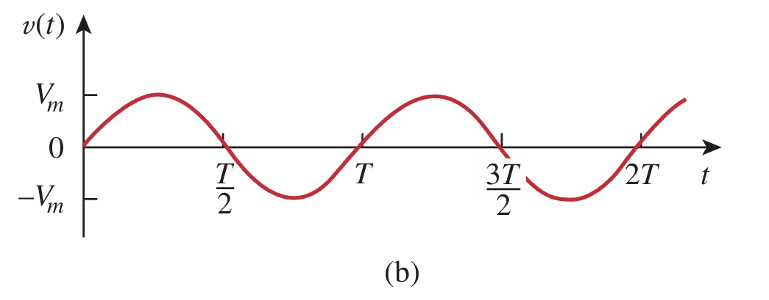
Sinusoids
The sinusoid is shown in Fig.(a) as a function of its argument and in Fig.(b) as a function of time.

Slide 5

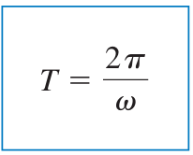
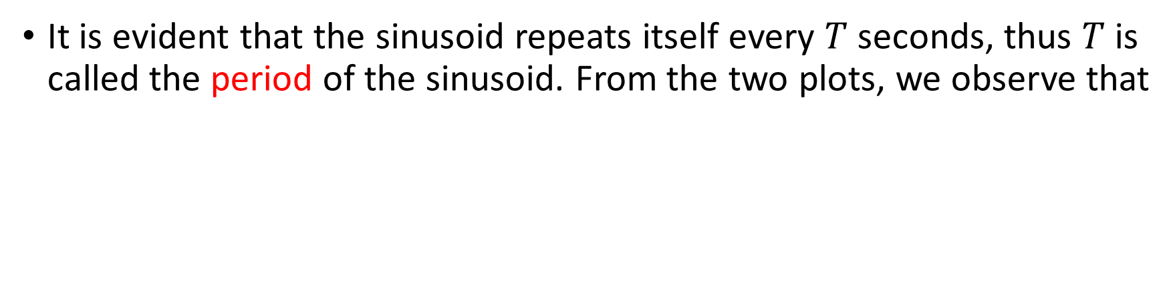
Sinusoids
It is evident that the sinusoid repeats itself every $T$ seconds, thus $T$ is called the period of the sinusoid. From the two plots, we observe that

Slide 6
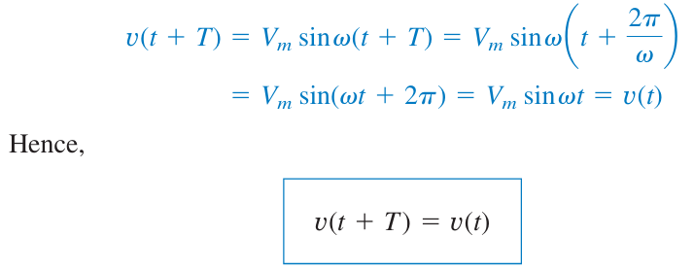

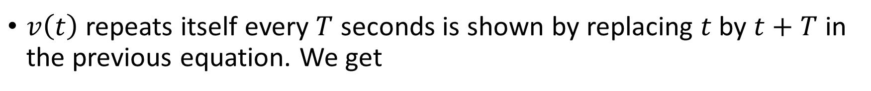
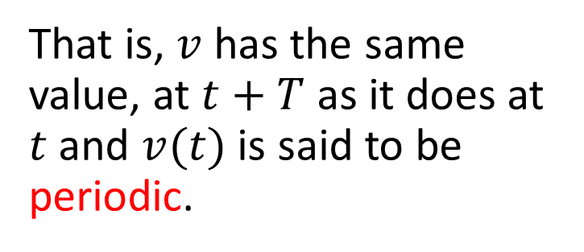
Sinusoids
$v\left(t\right)$repeats itself every $T$ seconds is shown by replacing $t$by $t+T$ in the previous equation. We get
That is, $v$ has the same value, at $t+T$ as it does at $t$ and $v(t)$ is said to be periodic.

Slide 7
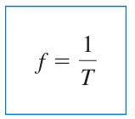

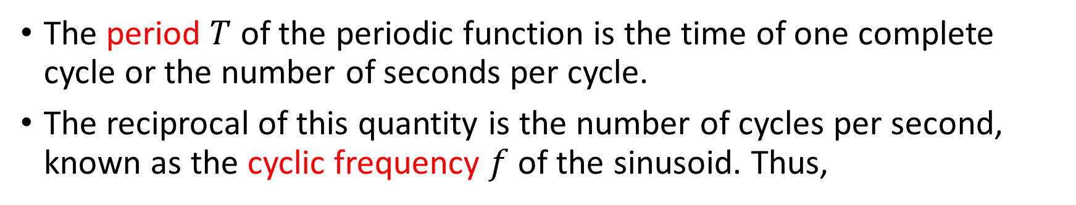
Sinusoids
The period $T$ of the periodic function is the time of one complete cycle or the number of seconds per cycle.
The reciprocal of this quantity is the number of cycles per second, known as the cyclic frequency $f$ of the sinusoid. Thus,

Slide 8
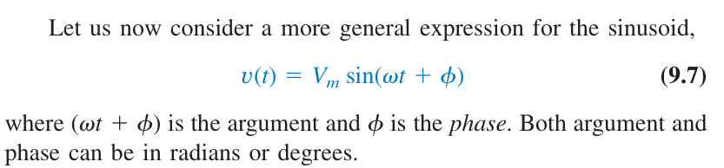
Sinusoids

Slide 9

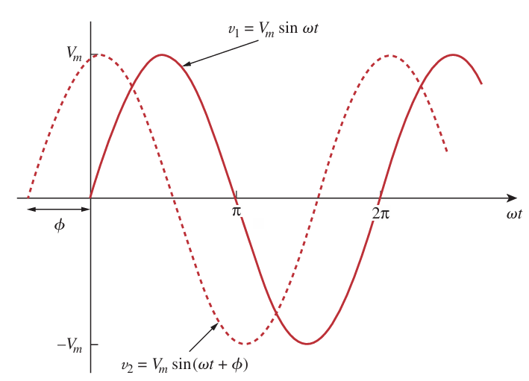
Sinusoids
v2 leads v1 by φ or
v1 lags v2 by φ.
If φ != 0, v1 and v2 are out of phase
If φ == 0, v1 and v2 are in phase

Slide 10
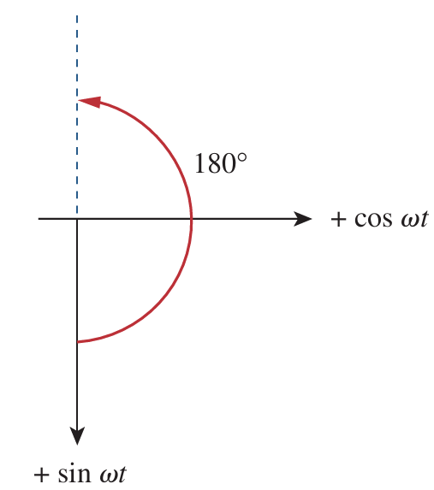
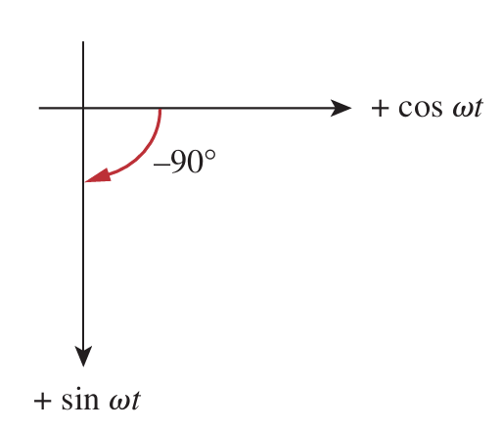
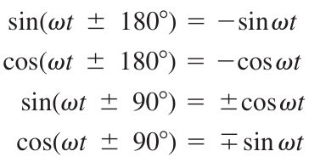
Sinusoids

Slide 11
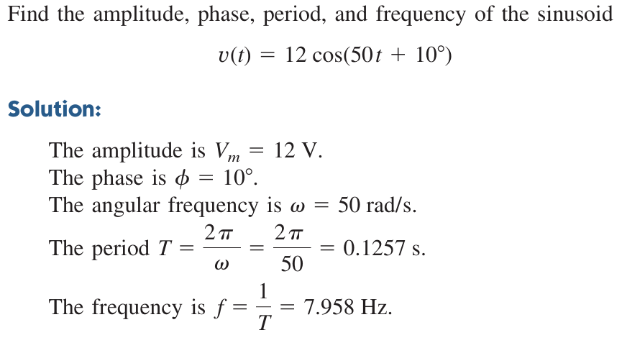
Math Problems

Slide 12
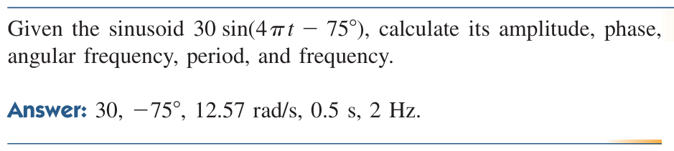
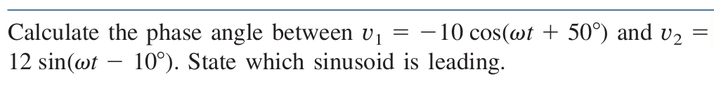
Math Problems

Slide 13
Math Problems

Slide 14
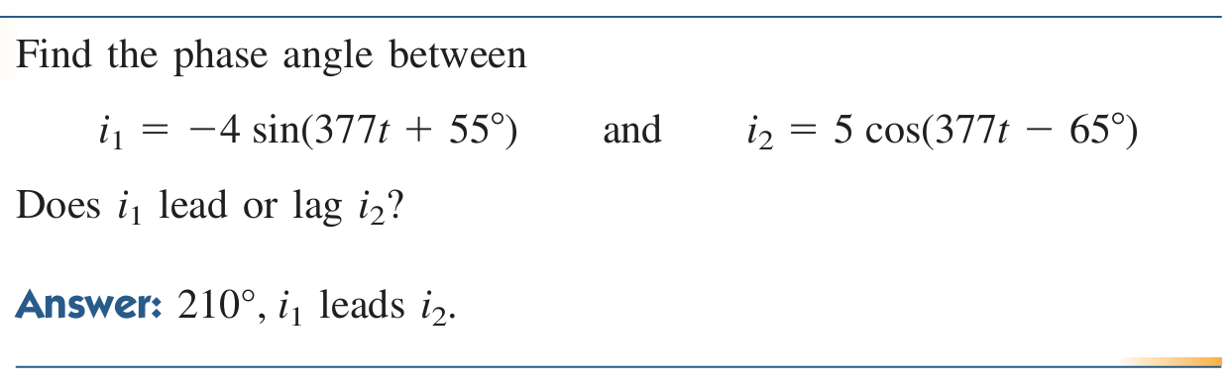
Math Problems

Slide 15
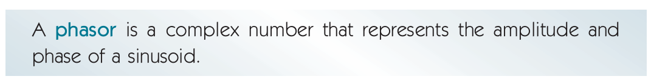
Phasors
Sinusoids are easily expressed in terms of phasors, which are more convenient to work with than sine and cosine functions.
A complex number $z$ can be written: $z=x+jy$ , where j = sqrt(-1)

Slide 16


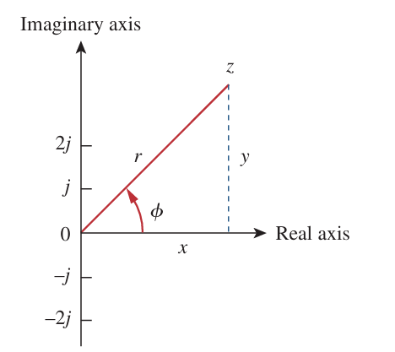
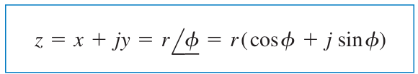
Phasors

Slide 17
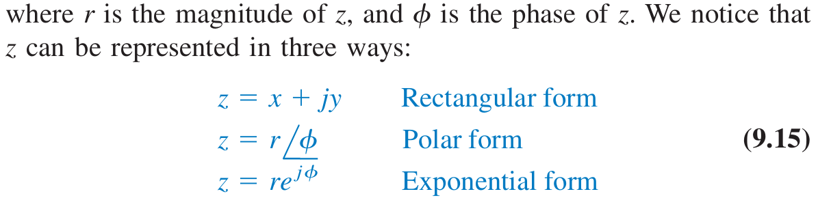
Phasors

Slide 18
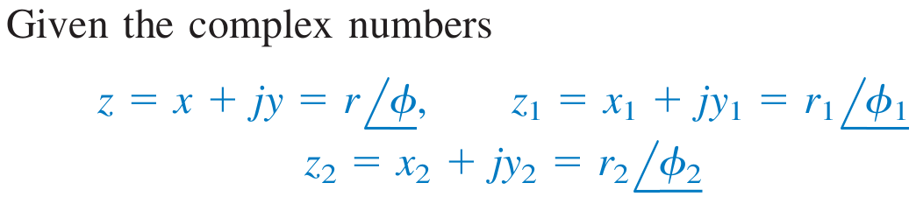
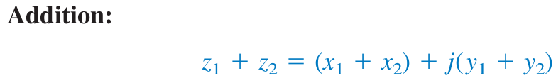
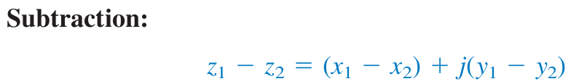
Phasors

Slide 19
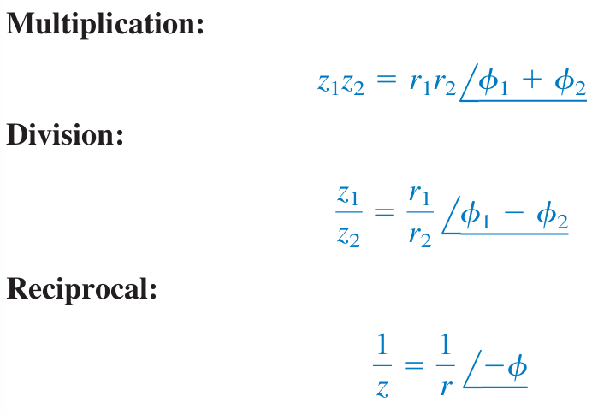
Phasors

Slide 20
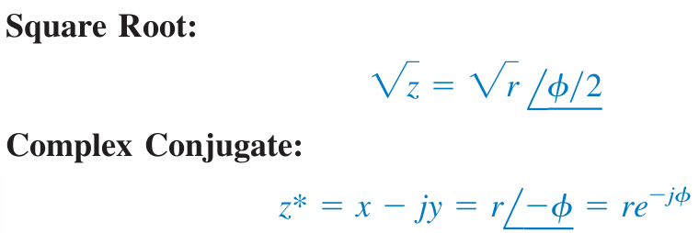
Phasors
These are the basic properties of complex numbers we need.

Slide 21
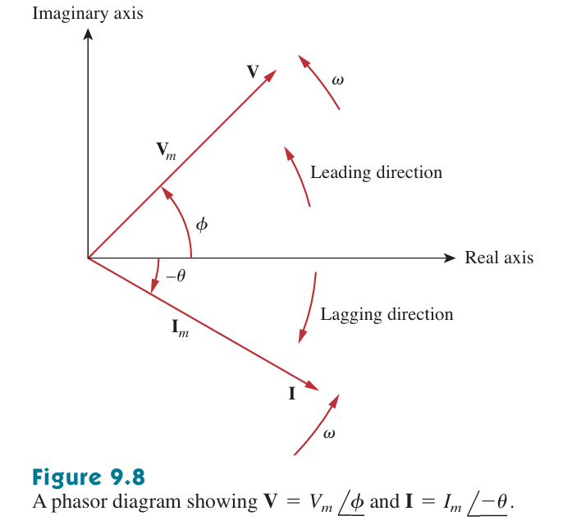
Phasors

Slide 22
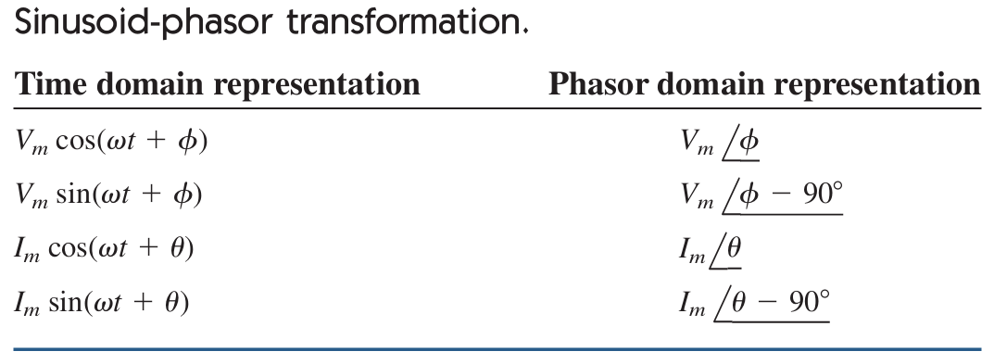
Phasors

Slide 23
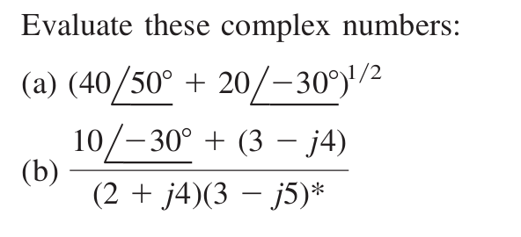
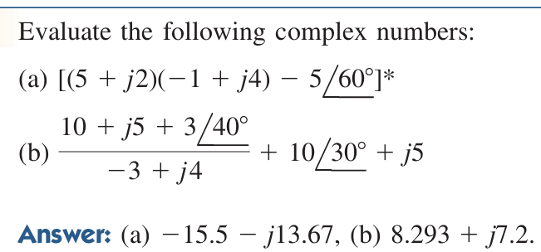
Practice Problems

Slide 24
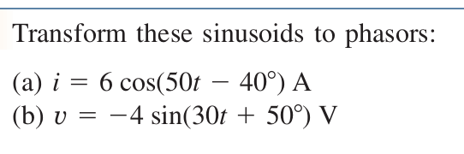
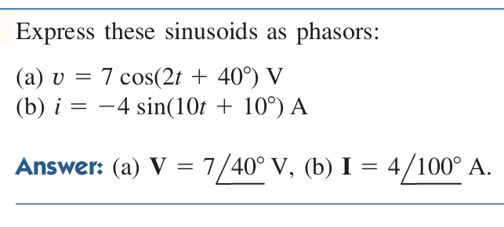
Practice Problems

Slide 25
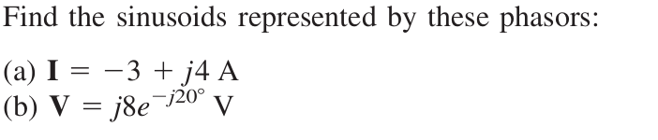
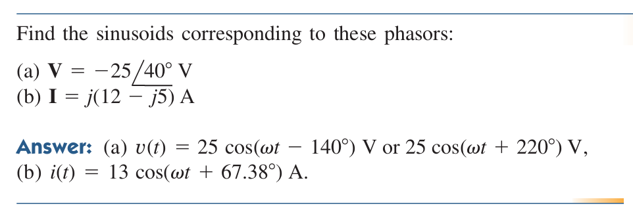
Practice Problems

Slide 26
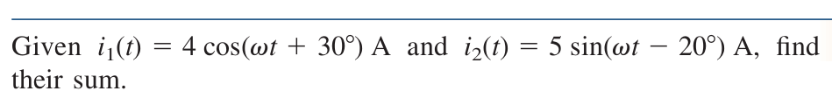
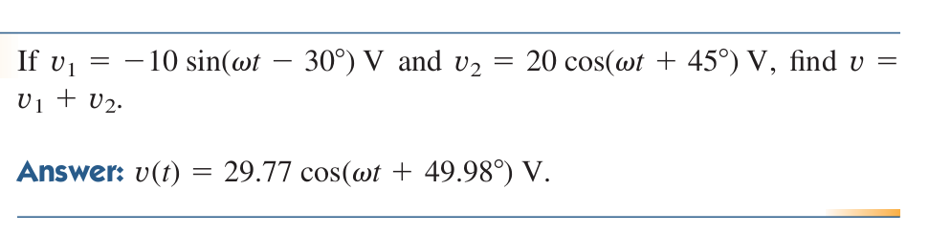
Practice Problems

